Slide 1
Spacy

Slide 2
It’s marketed as an “industrial-strength” Python NLP library that’s geared toward performance.
SpaCy is minimal and opinionated, and it doesn’t flood you with options like NLTK does. Its philosophy is to only present one algorithm (the best one) for each purpose. You don’t have to make choices, and you can focus on being productive.
Because it’s built on Cython, it’s also lightning-fast. Folks have called spaCy “state-of-the-art”
Spacy supports 18 languages
    to check the language support visit - https://spacy.io/usage/models

Slide 3
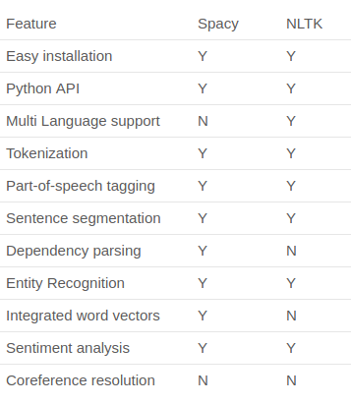

Slide 4
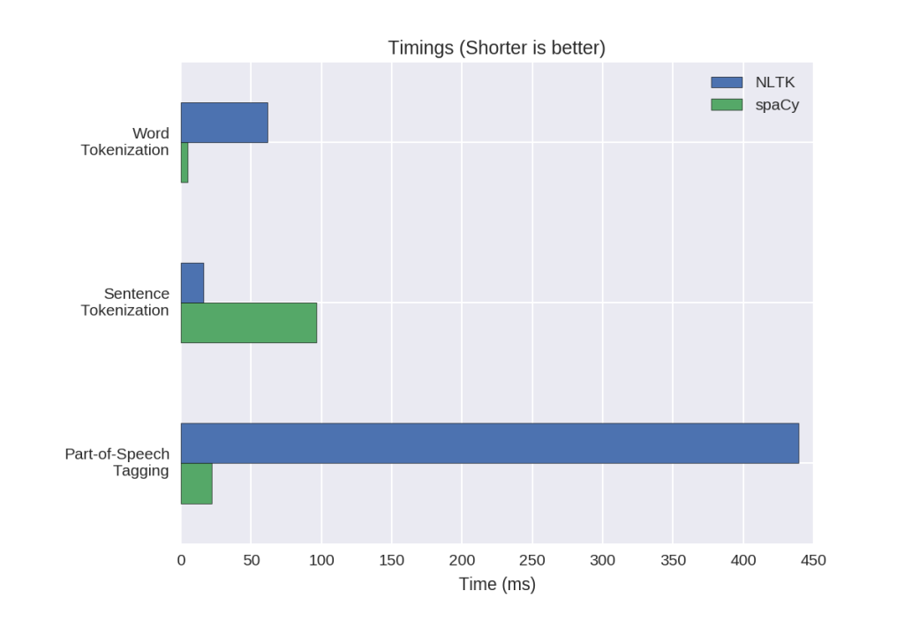

Slide 5
List of models in Spacy
https://spacy.io/models/en

Slide 6
Link to download the models
https://spacy.io/usage/models

Slide 7
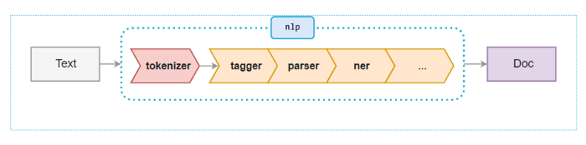
Spacy preprocessing Steps

Slide 8
Standford NLP

Slide 9
It contains tools, which can be used in a pipeline, to convert a string containing human language text into lists of sentences and words, to generate base forms of those words, their parts of speech etc.

Slide 10
This StanfordNLP package is built with highly accurate neural network components that enable efficient training and evaluation with your own annotated data.
The modules are built on top of PyTorch. You will get much faster performance if you run this system on a GPU-enabled machine

Slide 11
Now they have moved all the platform from standford nlp to stanza from Aug 2020
So we can work with standford nlp as well as they have not removed the support yet.

Slide 12
Stanza assists 66 human languages which was trained on a total of 112 datasets

Slide 13
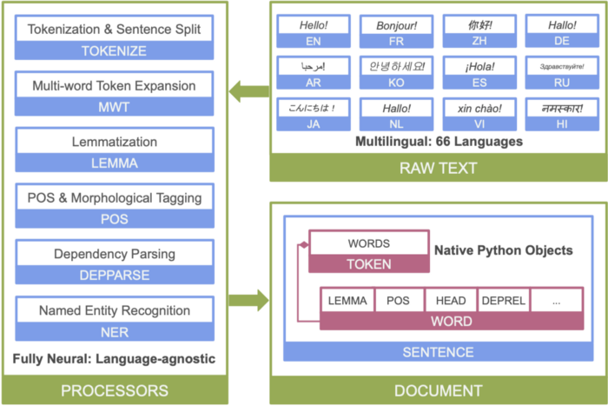
Pipeline

